Slide 1
我们7：05开始 ☺

Slide 2
CS1010 Placement Test AY2019-20 (17 July 2019) Liu Yuqi E-mail: e1513087@u.nus.edu +86 15823136901 The first draft of the solutions for AY2019-20 was provided by Liu Yuqi.
CS1010 Advanced Placement Credit
Examination Preparation for
S&T2025 Scholars (Set 11)

Slide 3
CS1010S Placement Test考什么？
每年因为不同的出题人，题型等可能有所变化
逻辑推理题
读懂题意，分类讨论
写代码/伪代码
用已知几个函数解决问题 ➔ 明白函数在做什么，有什么输出和输入
怎么利用已知
自己独立写来解决问题 e.g. anagram, rotated, palindromic…..
分析已知程序的output

Slide 4
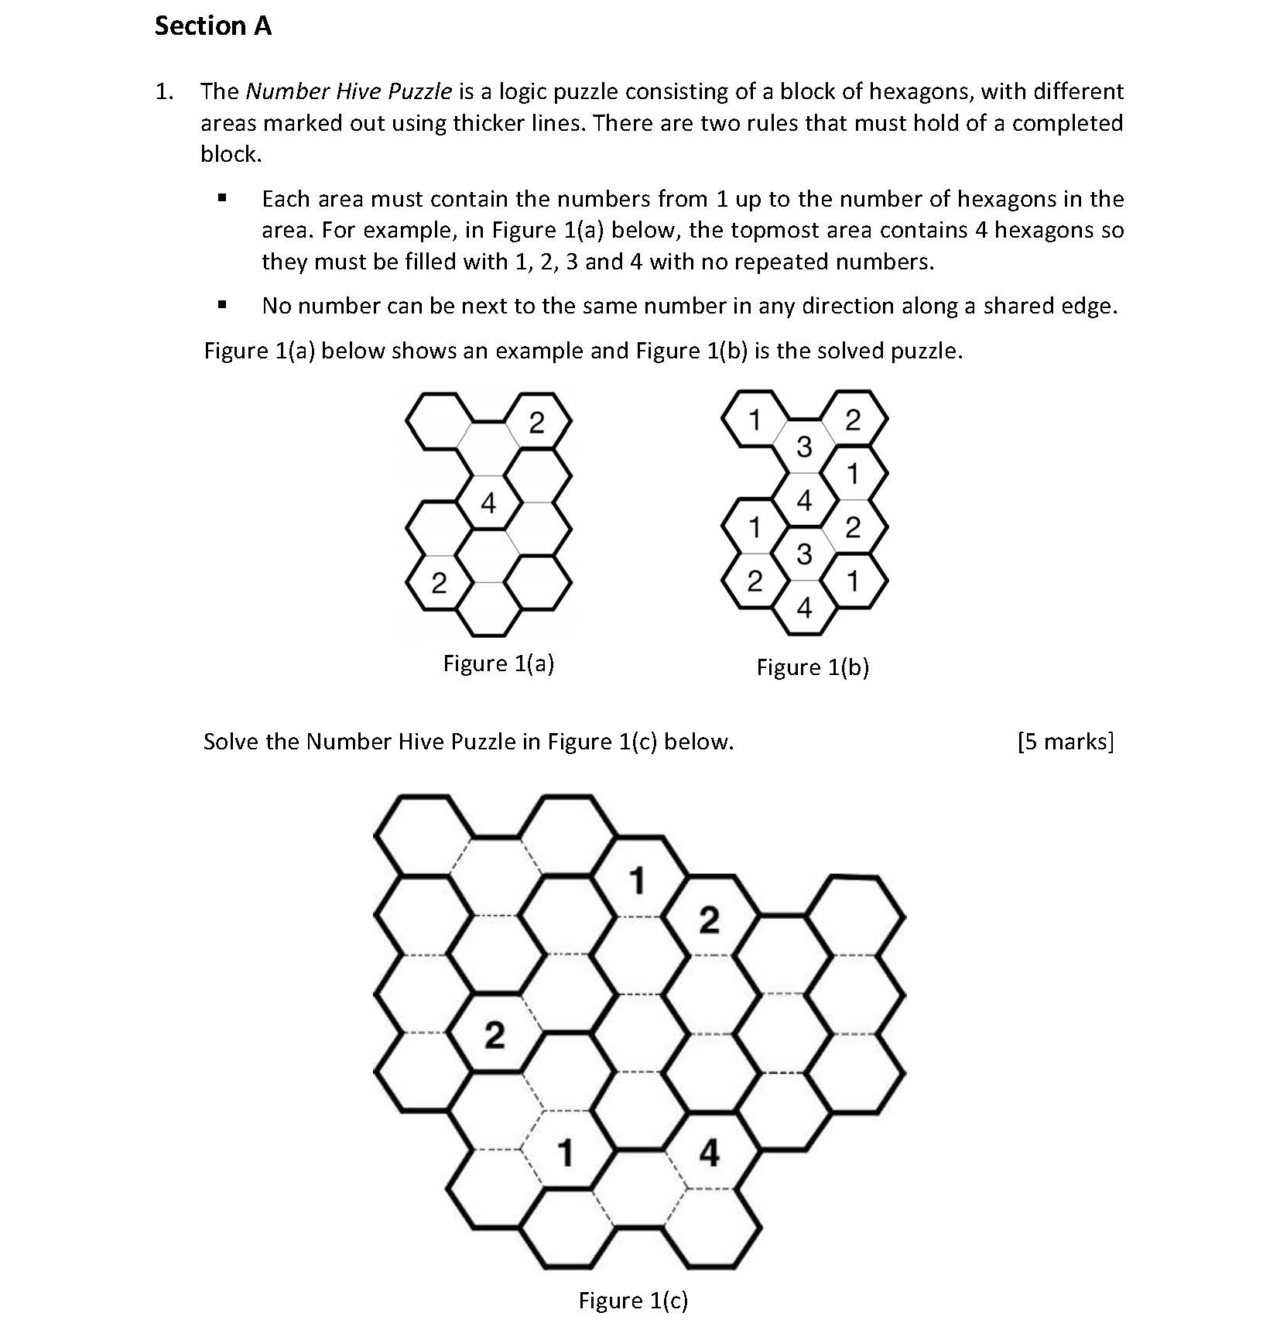
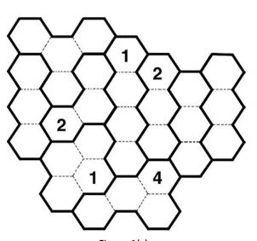
Answer:
Must have a 3
➔ In the red circle can only be 4
3 or 4

Slide 5
Can only be 4
To prevent two 1 next to each other
Have a try: 1-4-3-2
3
2
1
Cannot
Use 1-4-2-3
2
3
2
4
4
1
3
1
3
1
3
2
3
2
1
4
3
1
1
3
2
3
3
2
2
Can only be 3
3
1
To prevent two 2 next to each other
Can only be 2

Slide 6
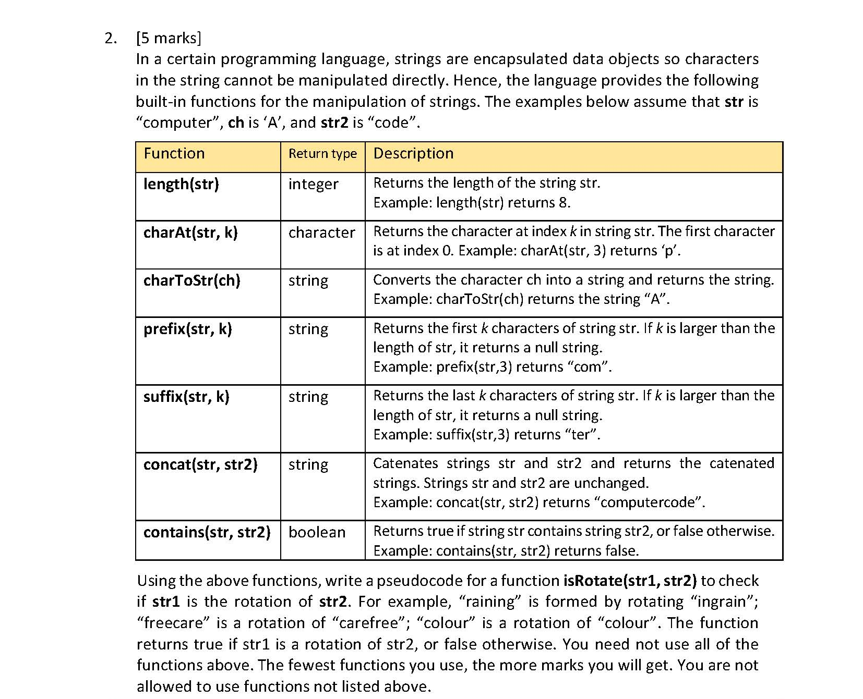
Answer:
How to rotate?
For example
raining
raining
➔ Repeat str1 twice, and try to find out whether there is a str2 “in” the new str1.

Slide 7
bool isRotate(char *str1, char *str2){
int len1, len2, i, j, k;
char *s;
len1=length(str1);
len2=length(str2);
if(len1!=len2) return false;
Check the length of the strings. If the lengths are different, str2 cannot be a rotated str1.
s=concat(str1, str1);
return contains(s, str2);
}
raining
raining

Slide 8

默认：不区分大小写
➔ Anagram = anagram

Slide 9
Answer: algorithm 1
#include <stdio.h>
#include <string.h>
#include <ctype.h> // For tolower()
#define NUM 256 // Assuming ASCII character set
int areAnagrams(const char *str1, const char *str2) {
int count[NUM] = {0};
int i;
if (strlen(str1) != strlen(str2))
return 0;
for (i = 0; str1[i]; i++) {
count[tolower(str1[i])]++;
count[tolower(str2[i])]--;
}
for (i = 0; i < NUM; i++) {
if (count[i] != 0)
return 0;
}
return 1;
}

Slide 10
Answer: algorithm 2
Compare the lengths of the strings
Idea:
Do sorting and make all the character in a certain order
➔ Check whether the two strings are the same.
Switch all letters to their lower forms
Bubble sort
Compare whether the two strings are the same

Slide 11
#include <stdio.h>
#include <string.h>
#include <ctype.h>
#include <stdlib.h>
void bubbleSort(char *str, int len) {
int i, j;
char temp;
for (i=0; i<len-1; i++) {
for (j=0; j<len-i-1; j++) {
if (str[j] > str[j+1]) {
temp=str[j];
str[j]=str[j+1];
str[j+1]=temp;
}
}
}
}
// Create copies to sort
char *copy1=(char *)malloc(len1+1);
char *copy2=(char *)malloc(len2+1);
strcpy(copy1, str1);
strcpy(copy2, str2);
toLowerStr(copy1, len1);
toLowerStr(copy2, len2);
bubbleSort(copy1, len1);
bubbleSort(copy2, len2);
result=(strcmp(copy1, copy2)==0);
free(copy1);
free(copy2);
return result;
}
void toLowerStr(char *str, int len) {
for (int i = 0; i < len; i++) {
str[i] = tolower(str[i]);
}
}
int areAnagramsBubbleSort(char *str1, char *str2) {
int len1=strlen(str1);
int len2=strlen(str2);
int result;
if (len1!=len2) return 0;
Create copies to sort?

Slide 12
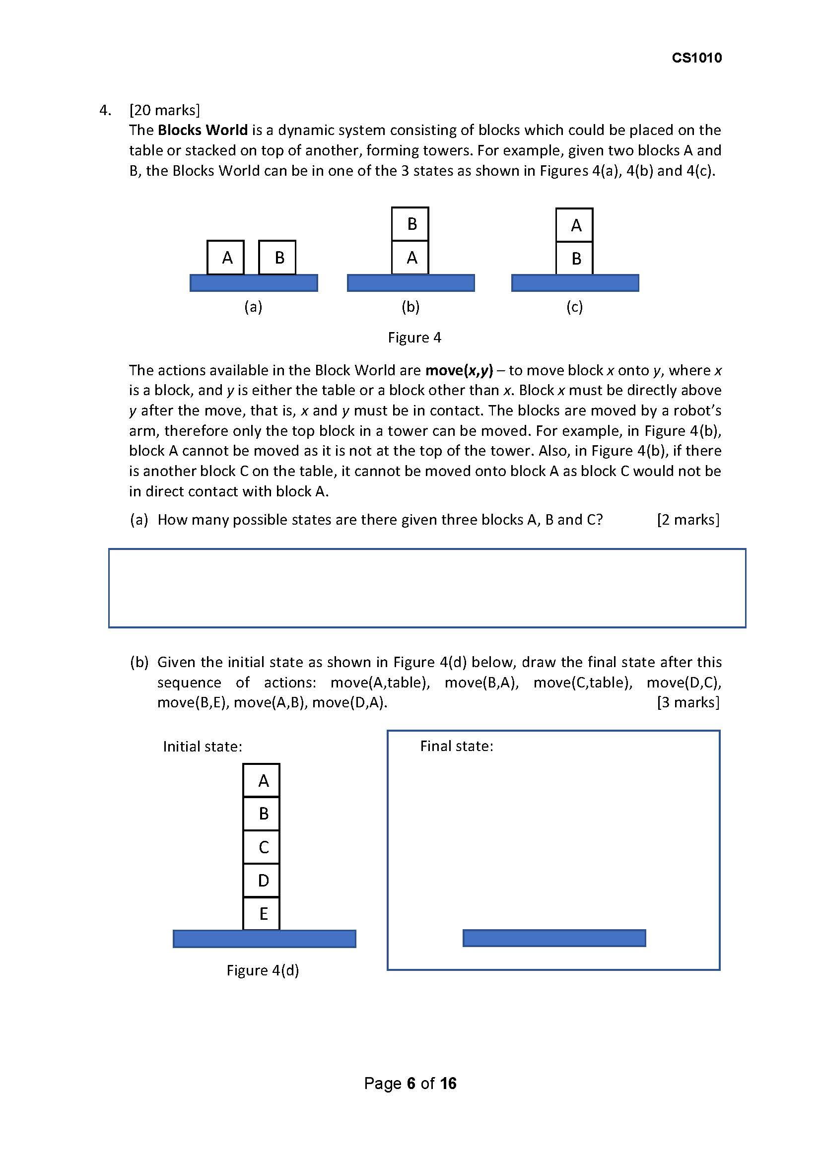
Answer:
13

Slide 13
A
B
C
1+1+1
(1)
B
A
C
A
C
B
A
C
B
C
A
C
B
B
A
C
A
2+1
B
(2)
(3)
(4)
(5)
(6)
(7)
C
B
C
A
A
B
B
C
A
C
B
A
3
A
A
B
B
C
C
(8)
(9)
(10)
(11)
(12)
(13)

Slide 14
Answer:
D
A
B
E
C

Slide 15

A
B
C
D
E
B
D
E
A
C

Slide 16
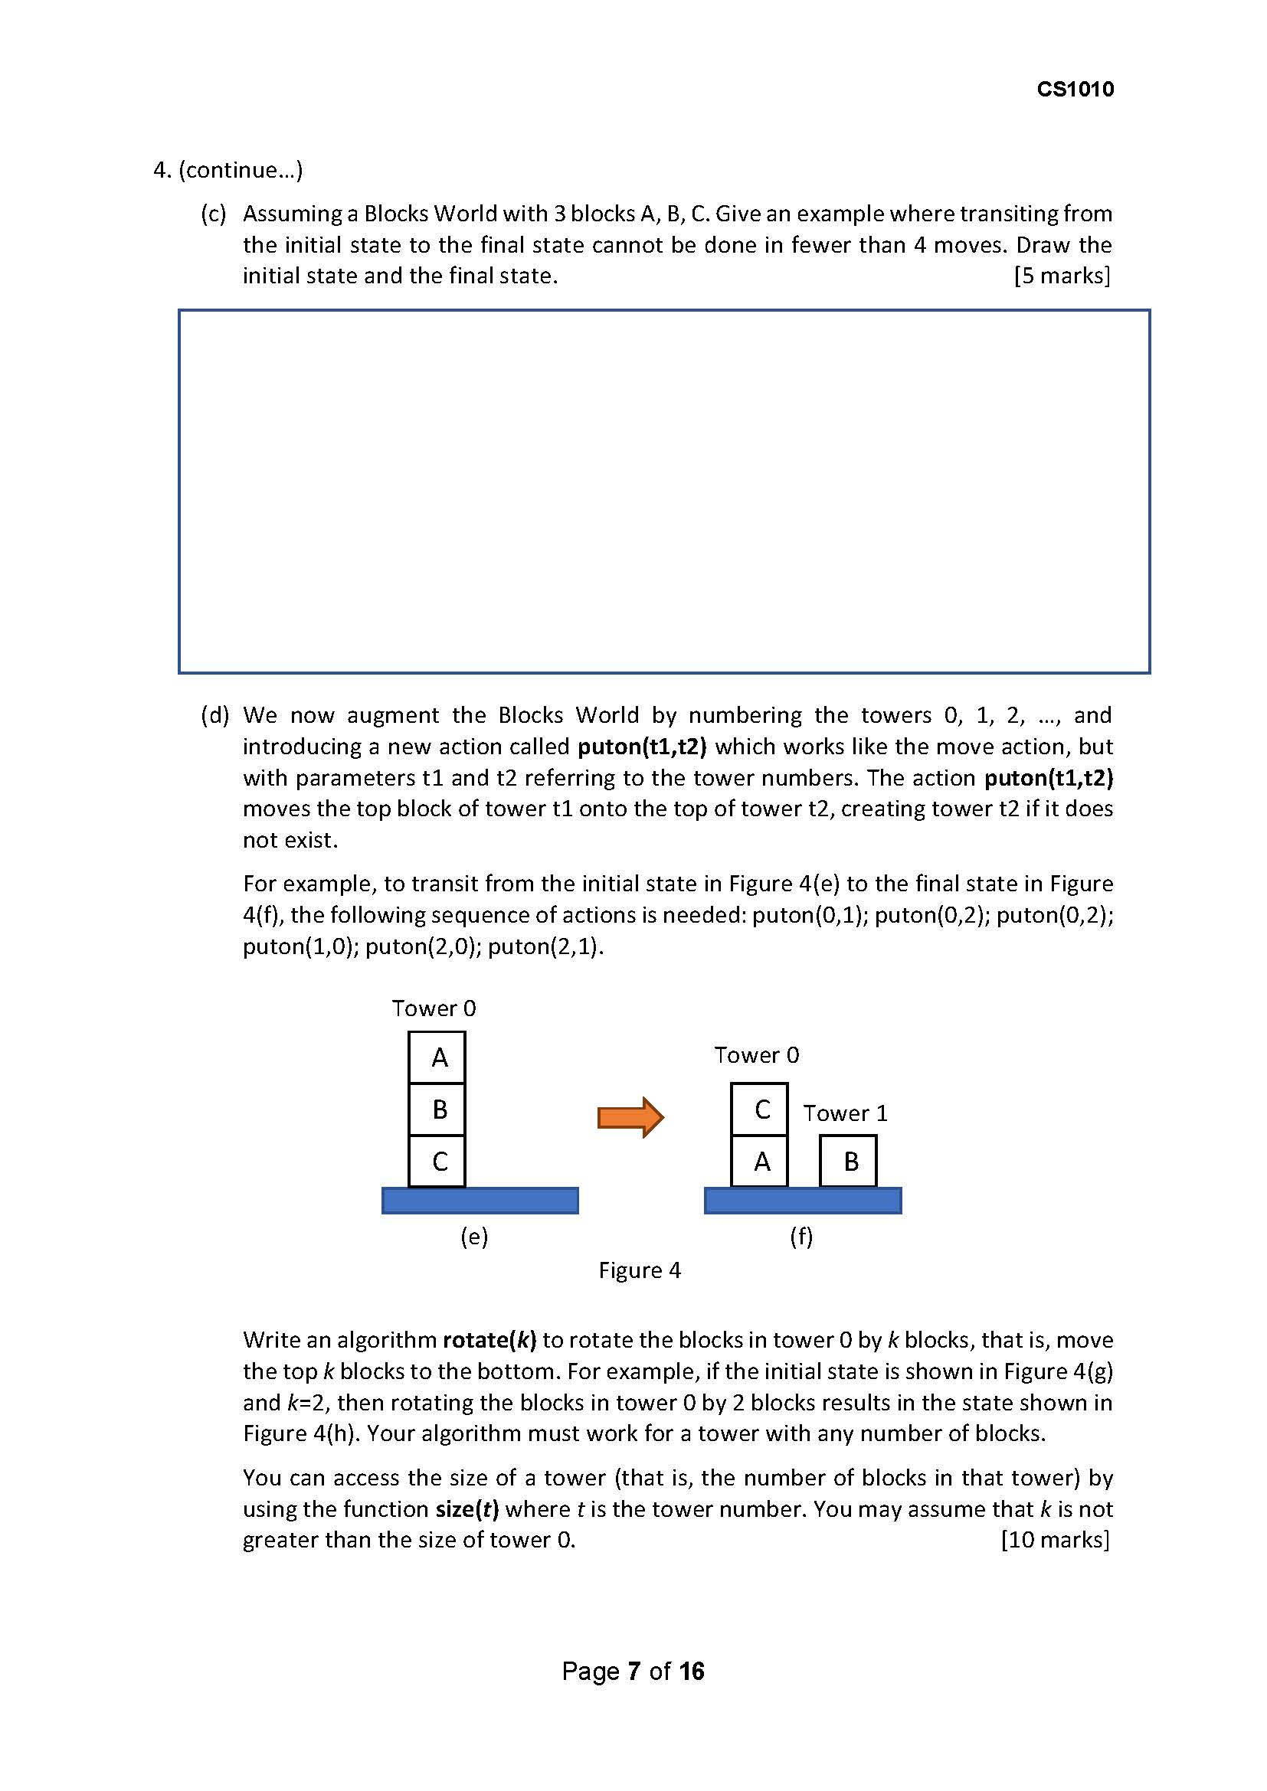
Answer:
A
B
B
C
C
A

Slide 17
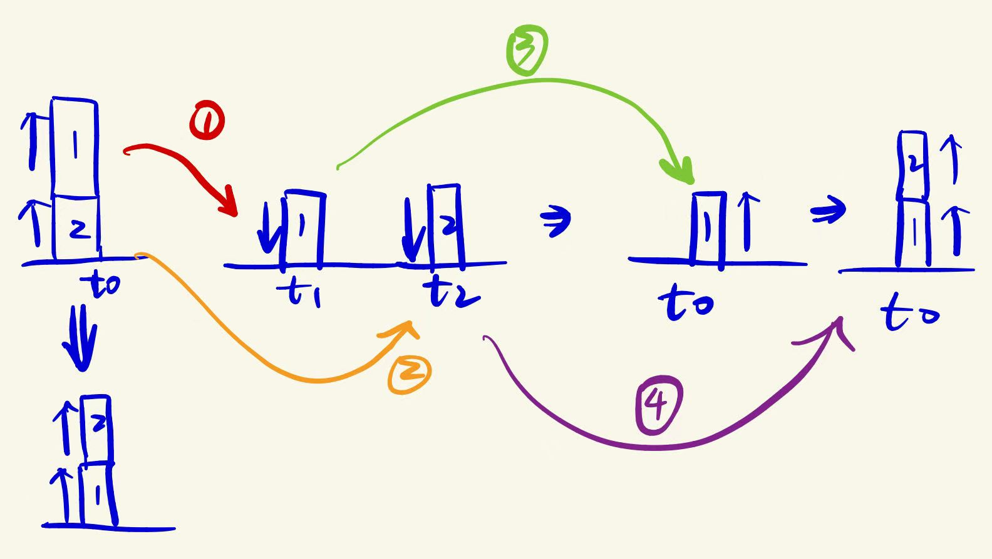
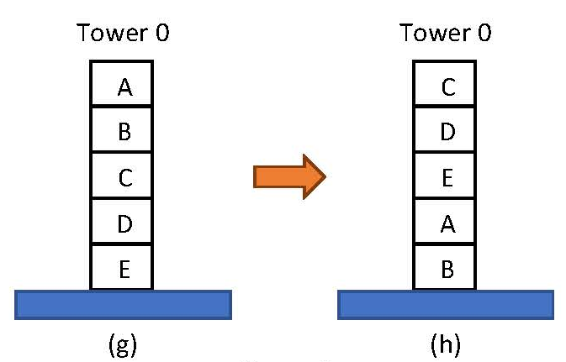
Answer:
rotate(int k) {
int total, i, j;
total=size(t0);
for(i=0; i<k; i++) {
puton(t0, t1);
}
for(j=0; j<total-k; j++)
puton(t0, t2);
for(i=0; i<k; i++)
puton(t1, t0);
for(j=0; j<total-k; j++)
puton(t2, t0);
}

Slide 18

bool is_Armstrong(int n) {
int sum=0;
int i=0;
int digit;
int t=n;
while(t>0) {
t=t/10;
i++;
}
t=n;
while(t>0){
digit=t%10;
t=t/10;
sum=pow(digit, i)+sum;
}
Or: keep an array to store all digits
Answer:
if(sum==n) return true;
else return false;
}
Cannot directly use n to do the operations, because in the end it needs the original n to compare with the sum.

Slide 19

Answer:
int is_palindromic(int n) {
// Base cases
if (n<0) return 0; // Negative numbers aren't palindromic
if (n<10) return 1; // Single-digit numbers are palindromic
Recursion思考方向：
最简单的情况？(base case)
每一层要做什么？
举例：Fibonacci sequence

Slide 20
int is_palindromic(int n) {
// Base cases
if (n<0) return 0; // Negative numbers aren't palindromic
if (n<10) return 1; // Single-digit numbers are palindromic
// Calculate the highest power of 10 less than n
int power=1;
while (power*10<=n) {
power *= 10;
}
// Compare first and last digits
int first_digit=n/power;
int last_digit=n%10;
if (first_digit!=last_digit) return 0;
// Remove first and last digits and recurse
return is_palindromic((n % power)/10);
}

Slide 21
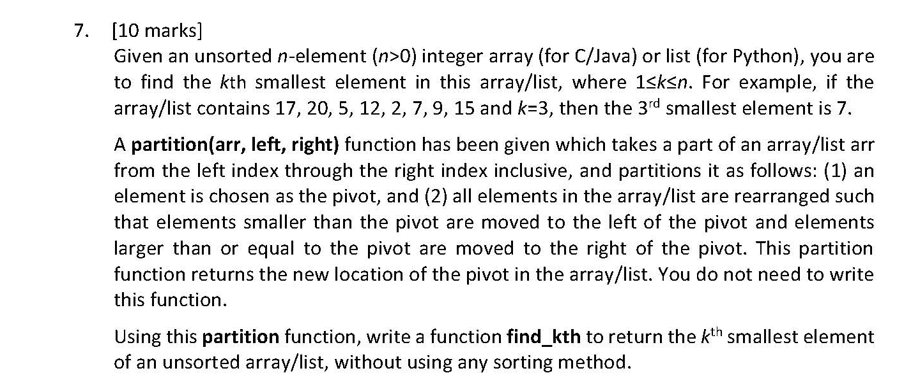
If the returned index equals to k-1
➔ Return the pivot element
If the returned index is greater than k-1
The kth smallest element is at the left side of the pivot element
Partition from left to the old pivot point
Answer:
Recursive function
…… pivot ……
If the returned index is smaller than k-1
The kth smallest element is at the right side of the pivot element
Partition from the old pivot point to the right
What is its relationship with the kth smallest element?

Slide 22
If the returned index equals to k-1
➔ Return the pivot element
#include <stdio.h>
int partition(int arr[], int left, int right);
int find_kth(int arr[], int left, int right, int k) {
int pivotIndex;
if (left==right) {
return arr[left];
}
pivotIndex = partition(arr, left, right);
if (k-1==pivotIndex) {
return arr[pivotIndex];
} else if (k - 1<pivotIndex) {
return find_kth(arr, left, pivotIndex-1, k);
} else {
return find_kth(arr, pivotIndex+1, right, k);
}
}
If the returned index is greater than k-1
The kth smallest element is at the left side of the pivot element
Partition from left to the old pivot point
If the returned index is smaller than k-1
The kth smallest element is at the right side of the pivot element
Partition from the old pivot point to the right

Slide 23

Answer:
本质：给对应的两个char交换位置
（个数为奇/偶均同理）
void reverse(char str[], int left, int right) {
while (left<right) {
char temp=str[left];
str[left]=str[right];
str[right]=temp;
left++;
right--;
}
}

Slide 24

Answer:
The fox jumps over the lazy dog
god yzal eht revo spmuj xof ehT
Reverse the entire string
Reverse each word in the reversed string
dog lazy the over jumps fox The
关键：利用上一问的reverse function

Slide 25
void reverse_string(char str[]) {
int n=strlen(str);
// Step 1: Reverse the entire string
reverse(str, 0, n-1);
// Step 2: Reverse each word in the reversed string
int start=0;
for (int i=0; i<=n; i++) {
if (str[i]== ‘ ’ || str[i]==‘\0’) {
reverse(str, start, i - 1);
start=i+1;
}
}
}

Slide 26
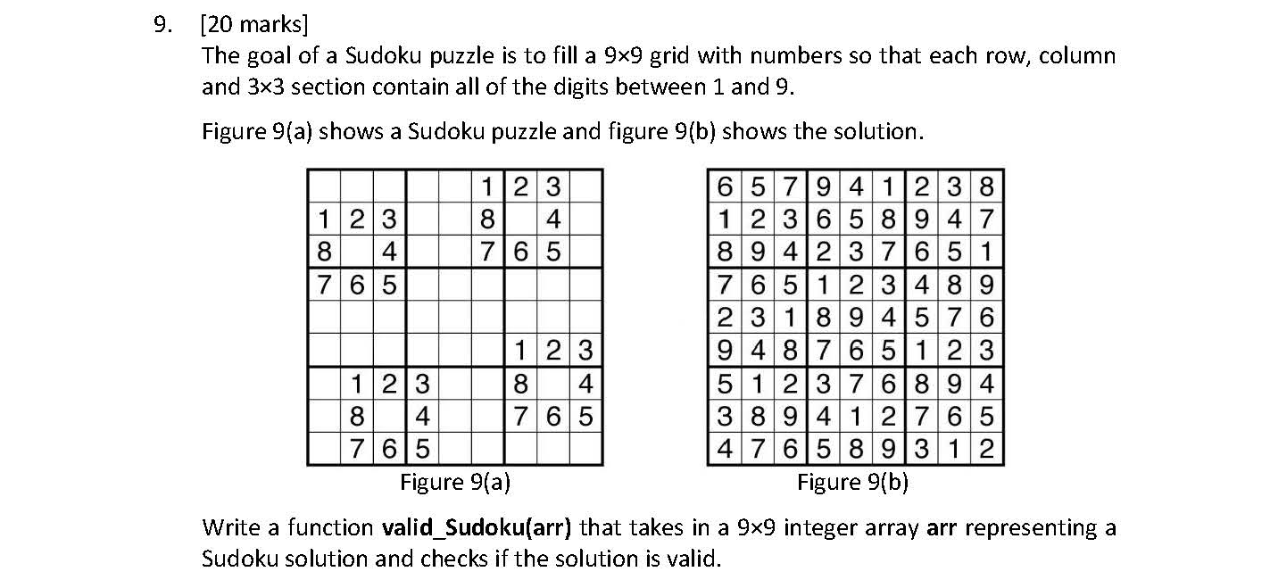
Answer:
What the function should do:
Check all the columns whether the numbers are from 1 to 9.
Check all the rows whether the numbers are from 1 to 9.
Check all the small grids whether the numbers are from 1 to 9.

Slide 27
Answer:
int valid_sudoku(int arr[][9]){
int check[9]={0},i,j,k,p;
//check the columns
for(i=0; i<9; i++){
for(j=0; j<9; j++){
if (arr[i][j] < 1 || arr[i][j] > 9) return 0;
check[arr[i][j]-1]++;
}
for(j=0; j<9; j++){
if(check[j]!=1) return 0;
check[j]=0;
}
}
//check the rows
for(i=0; i<9; i++){
for(j=0; j<9; j++){
if (arr[j][i] < 1 || arr[j][i] > 9)
return 0;
check[arr[j][i]-1]++;
}
for(j=0; j<9; j++){
if(check[j]!=1) return 0;
check[j]=0;
}
}
Need to check whether the number is within the range, or check[arr[j][i]-1] may cause trouble

Slide 28
Answer:
//check the small grids
for(k=0; k<3; k++){
for(p=0; p<3; p++){
for(i=p*3; i<p*3+3; i++){
for(j=k*3; j<k*3+3; j++){
if (arr[i][j] < 1 || arr[i][j] > 9)
return false;
check[arr[i][j]-1]++;
}
}
for(j=0; j<9; j++){
if(check[j]!=1) return 0;
check[j] = 0;
}
}
}
return 1;
}

Slide 29
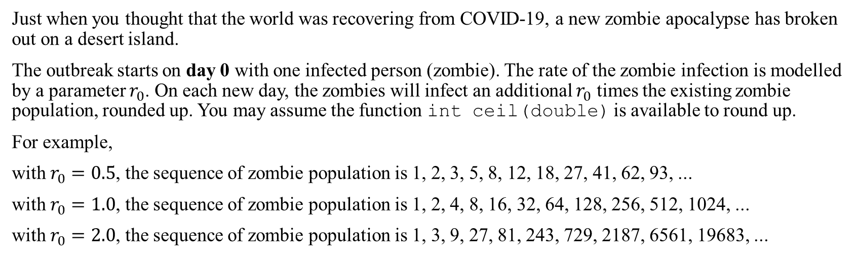
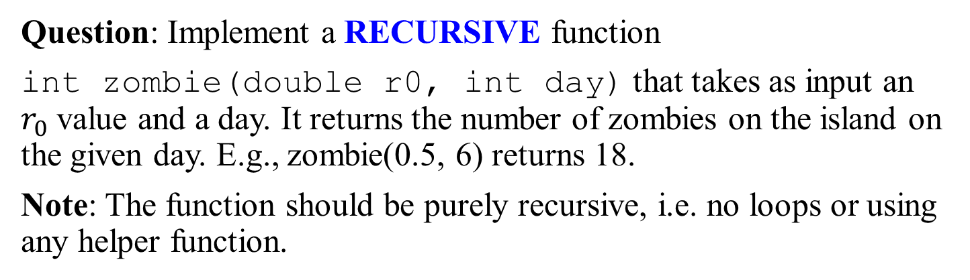
Qn 1 Zombie Island Apocalypse 僵尸岛启示录 (Part B)
Just when you thought that the world was recovering from COVID-19, a new zombie apocalypse has broken out on a desert island.
The outbreak starts on day 0 with one infected person (zombie). The rate of the zombie infection is modelled by a parameter $r_{0}$. On each new day, the zombies will infect an additional $r_{0}$ times the existing zombie population, rounded up. You may assume the function int ceil(double) is available to round up.
For example,
with $r_{0}=0.5$, the sequence of zombie population is 1, 2, 3, 5, 8, 12, 18, 27, 41, 62, 93, ...
with $r_{0}=1.0$, the sequence of zombie population is 1, 2, 4, 8, 16, 32, 64, 128, 256, 512, 1024, ...
with $r_{0}=2.0$, the sequence of zombie population is 1, 3, 9, 27, 81, 243, 729, 2187, 6561, 19683, ...
f(n-1) + roundup[f(n-1) * r0 ]
Question: Implement a RECURSIVE function
int zombie(double r0, int day) that takes as input an $r_{0}$ value and a day. It returns the number of zombies on the island on the given day. E.g., zombie(0.5, 6) returns 18.
Note: The function should be purely recursive, i.e. no loops or using any helper function.
Base case: day = 0

Slide 30
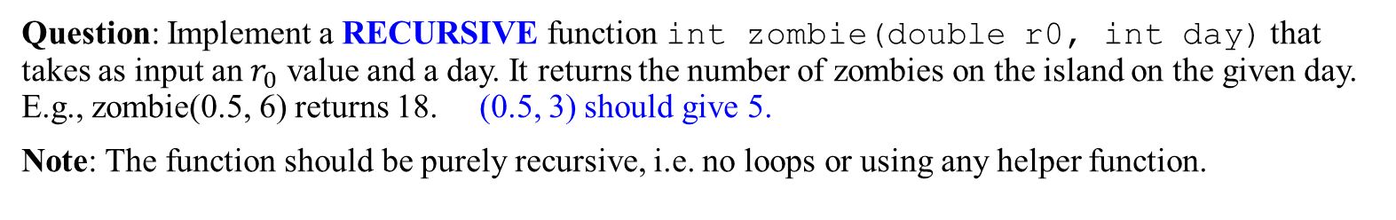
Qn 1 Zombie Island Apocalypse (Part B)
Question: Implement a RECURSIVE function int zombie(double r0, int day) that takes as input an $r_{0}$ value and a day. It returns the number of zombies on the island on the given day. E.g., zombie(0.5, 6) returns 18. (0.5, 3) should give 5.
Note: The function should be purely recursive, i.e. no loops or using any helper function.
Answer:
#include <stdio.h>
#include <math.h> // For the ceil function
// Part B: Recursive approach
int zombie_recursive(double r0, int day)
{
int previous;
if (day == 0)
return 1;
else
{
previous = zombie_recursive(r0, day-1);
return previous + (int)ceil(previous*r0);
}
}
main()
{
printf ("\n%d", zombie_recursive(0.5,3));
}
(0.5, 3)
previous = (0.5, 2)
previous = (0.5, 1)
previous = (0.5, 0)
return 1
1
return (previous + previous x 0.5)
2
return (previous + previous x 0.5)
3
return (previous + previous x 0.5)
5

Slide 31

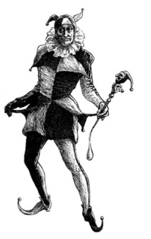
Qn 7 Knights and Knaves
On an island, the islanders are of two types: knights and knaves.
Knights always tell the truth, while knaves always lie.
Identify the islanders in each of the parts below.
If A is Knight, A can be trusted.
So B is knave.
So B cannot be trusted. So
“Neither of us are knaves” is wrong.
So either both are knight (No), or A is Knight (Yes) or B is knave (Yes).
So A is Knight and B is knave.
You met two islanders A and B A says, “B is a knave.” B says, “Neither of us are knaves”. What are A and B?
Answer:
If A is Knave, A cannot be trusted.
So B is Knight.
So B can be trusted. So
“Neither of us are knaves” is right.
So A is not Knave - contradiction
A: knight
B: knave

Slide 32
Alternate Approach:
1) A’s identity | 2) B’s identity | 3) What A says | 4) What B says | 5) Contradictory?
Knight | Knight | True B is a knave | True A and B are both knights | 2) & 3) / 3) & 4) contradictory
Knight | Knave | True B is a knave | False A and B are not both knights | √
Knave | Knight | False B is a knight | True A and B are both knights | 1) & 4) contradictory
Knave | Knave | False B is a knight | False A and B are not both knights | 2) & 3) contradictory
A: knight B: knave
Provided by Liu Yuqi.

Slide 33
Q&A
如有疑问，请在聊天框发出题号和问题 ;)

Slide 34
- End -
Acknowledgement: The first draft of these solutions was provided by Liu Yuqi.

